Slide 1
Introduction: a public health perspective on asbestos-related diseases
Dr Matthew Soeberg, Epidemiologist, Asbestos Diseases Research Institute
10 July 2019

Slide 2
Four key concepts
Asbestos exposure and cancer
Asbestos-related diseases
Latency period between exposure and disease
Descriptive epidemiology of asbestos-related disease

Slide 3
Asbestos exposure and cancer

Slide 4
Asbestos as carcinogenic agent as defined by IARC

Slide 5
IARC Summary of evidence: asbestos and cancer
“There is sufficient evidence in humans for the carcinogenicity of all forms of asbestos (chrysotile, crocidolite, amosite, tremolite, actinolite, and anthophyllite). Asbestos causes mesothelioma and cancer of the lung, larynx, and ovary.”

Slide 6
Asbestos as a carcinogen
“All forms of asbestos including chrysotile asbestos are carcinogenic. To prevent future generations from these avoidable cancers, it is time for governments in asbestos-producing and consuming countries to heed the WHO's advice and stop the use of all forms of asbestos.”
Dr Maria Neira, Director, Public Health and Environment,
World Health Organization
10 February 2014

Slide 7
Asbestos-related diseases

Slide 8
Asbestos exposure and disease
Asbestos exposure
Cancer
Non-cancer
Malignant mesothelioma
Asbestos-related lung cancer
Asbestos-related laryngeal cancer
Asbestos-related ovarian cancer
Asbestosis
Pleural plaques

Slide 9
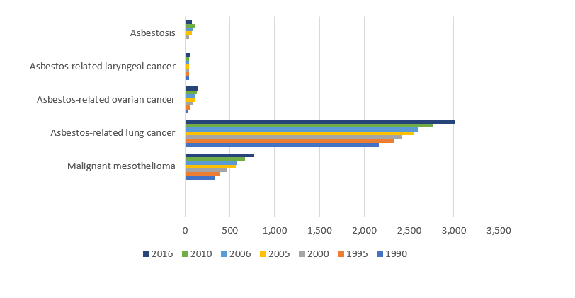
Global burden of disease (GBD) data for Australia, 1990 to 2016

Slide 10
Latency period

Slide 11
The public health perspective of asbestos-related diseases
Latency period between exposure and disease
Up to 40-50 years for malignant mesothelioma
Around 20 years for asbestosis
Survival time
9-12 month survival time between malignant mesothelioma and death
Diagnosis of asbestos-related disease
Asbestos exposure
Death

Slide 12
Example of gap between peaks in asbestos consumption and asbestos-related disease in the population
If an asbestos consuming country banned asbestos today, the asbestos-related disease epidemic would only peak in another 40 years from now.
2019
2059
Peak in a country’s asbestos consumption
Peak in the asbestos-related disease epidemic

Slide 13
Descriptive epidemiology

Slide 14
Common population-based descriptive epidemiology metrics
Cancer incidence
Number of new cases per year
Crude incidence rates
Age-standardised incidence rates
Trends over time and projections in incidence
Cancer mortality
Number of deaths per year
Crude mortality rates
Age-standardised mortality rates
Trends over time in mortality
Cancer survival
1-year relative survival (observed survival compared to expected survival)
5-year relative survival (observed survival compared to expected survival)

Slide 15
What do we know about the descriptive epidemiology of malignant mesothelioma?
Asbestos consumption varies across countries
Age-standardised incidence rates in high asbestos consuming countries can range between 1-4 per 100,000
Data quality differs across countries
Cancer incidence
Number of new cases per year
Crude incidence rates
Age-standardised incidence rates
Trends over time and projections in incidence
Cancer mortality
Number of deaths per year
Crude mortality rates
Age-standardised mortality rates
Trends over time in mortality
Cancer survival
1-year relative survival (observed survival compared to expected survival)
5-year relative survival (observed survival compared to expected survival)
Mesothelioma has a poor prognosis (poor survival)
Mortality rates are similar to incidence rates

Slide 16
Group exercise – incidence data for the Philippines
Given what you know about the health of your community and about the epidemiology of asbestos-related diseases, how many people did WHO report were newly diagnosed with malignant mesothelioma in the Philippines between 2008 and 2012?
Less than 50 new cases in total between 2008 and 2012
Between 50 and 99 new cases in total between 2008 and 2012
Between 100 and 199 new cases in total between 2008 and 2012
More than 200 new cases in total between 2008 and 2012

Slide 17
Answer– incidence data
IARC/WHO reports a total of 19 new cases of malignant mesothelioma in the Philippines during the 5-year period 2008 to 2012.
IARC/WHO also report a total of 33 new cases of malignant mesothelioma in the Philippines in the total period between 1998 and 2012.

Slide 18
Group exercise – mortality data for the Philippines
Given what you know about the health of your community and about the epidemiology of asbestos-related diseases, how many people did WHO report as having died each year from malignant mesothelioma in the Philippines between 2006 and 2011?
Less than 10 people die each year in the Philippines from malignant mesothelioma
Between 10 and 24 people die each year in the Philippines from malignant mesothelioma
Between 25 and 49 people die each year in the Philippines from malignant mesothelioma
At least 50 people die each year in the Philippines from malignant mesothelioma

Slide 19
Answer– mortality data
WHO reports a total of 44 malignant mesothelioma deaths in the Philippines during the 6-year period 2006 to 2011.

Slide 20
Under reporting of malignant mesothelioma data
Some food for thought….
Do you think these WHO incidence and mortality data under represent the ‘true’ burden of malignant mesothelioma in the Philippines?
If so, by how much?
What can you do to provide more accurate data from cancer registries and death certificates?

Slide 21
Thank you

